Slide 1
Predicting Stock Price based on Trading Indicators
Enrique Briceno, Thomas Guyton, and Erik McFarlane

Slide 2
Approach
Select three stocks based on volatility (High, Avg, & Low as measured by the stock’s Beta)
Select three different trading indicators (MACD, Commodity Channel Indicator (CCI), and Money Flow Index (MFI)
Apply two different ML libraries (SVC & LTSM) to attempt to predict stock prices and indicators based off of those indicators and to see if different indicators work better for different classes of stocks (based on volatility)

Slide 3
The Securities (3 stocks)
High (Volatility) Beta = OSTK
Avg (Volatility) Beta = CAT
Low (Volatility) Beta = DGX

Slide 4
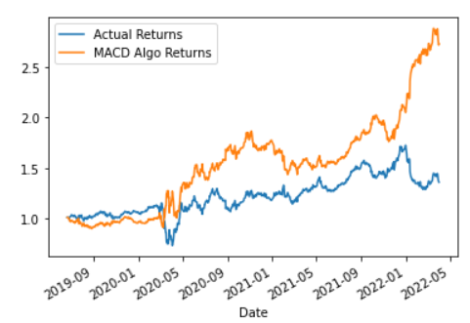
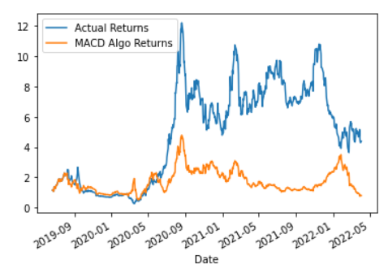
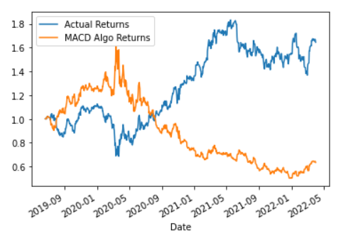
ML #1: MACD & SVC/Standard Scalar
Used SVC/Standard Scalar to predict the MACD “Buy/Sell” signal and percent change:
MACD relies on combined values versus a single value to generate signal
DGX
OSTK
CAT

Slide 5
#2: CCI & LTSM
Attempt to predict the prices by applying LTSM to CCI & MFI
Attempt to predict the indicator by applying LTSM to CCI & MFI
Manipulated window size, # of layers, and # of units to attempt to get better results
Based on predicted indicator calculated returns

Slide 6
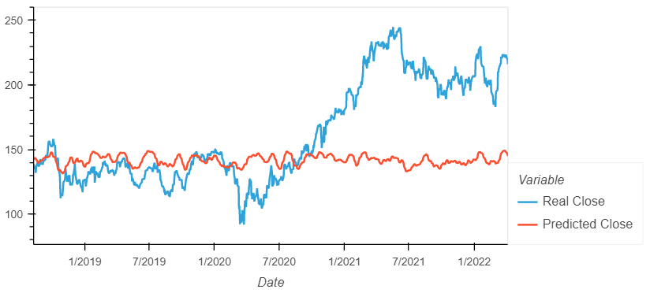
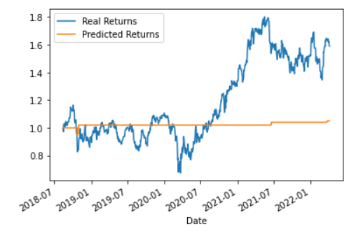
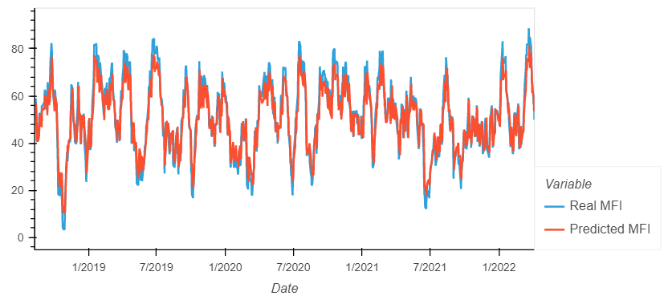
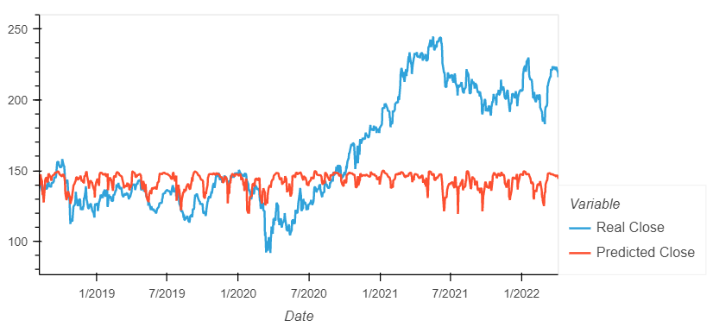
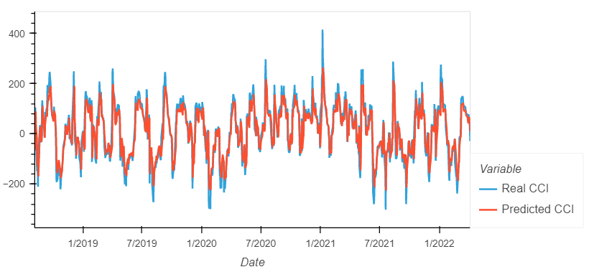
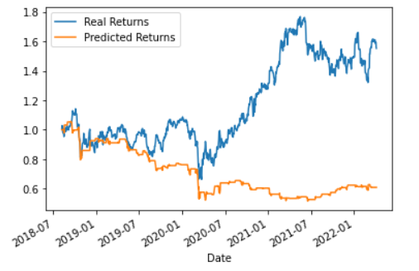
CAT
MFI
CCI
Using INDICATOR to predict CLOSE
Using INDICATOR to predict INDICATOR
Compared RETURNS

Slide 7
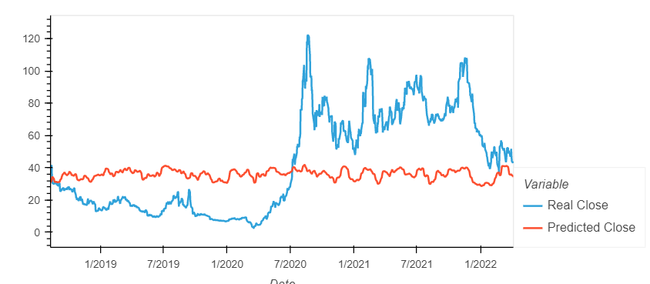
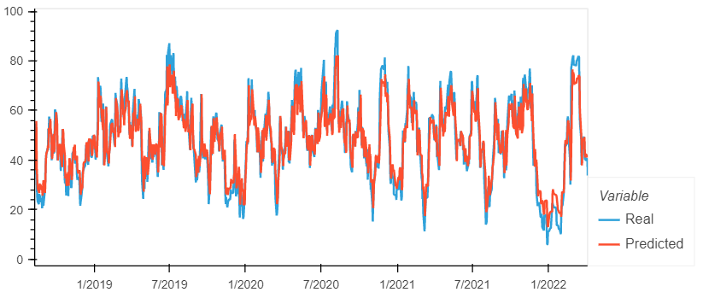
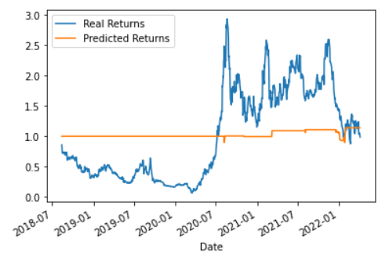
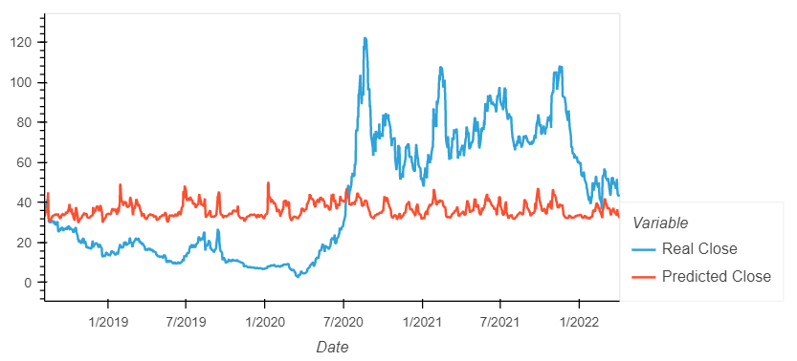
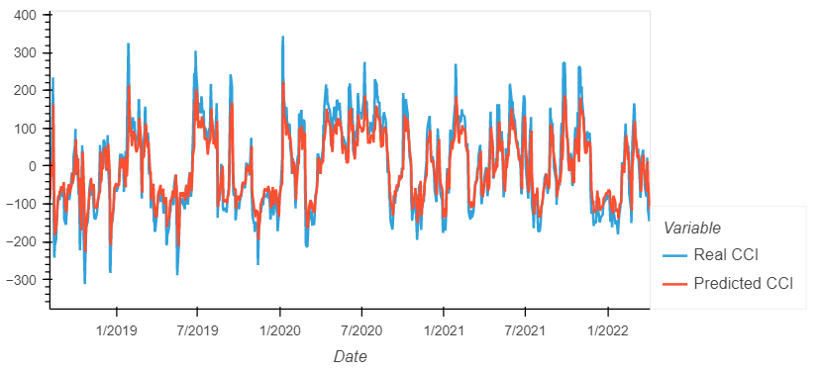
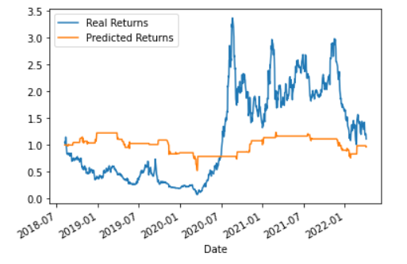
OSTK
MFI
CCI
Using INDICATOR to predict CLOSE
Using INDICATOR to predict INDICATOR
Compared RETURNS

Slide 8
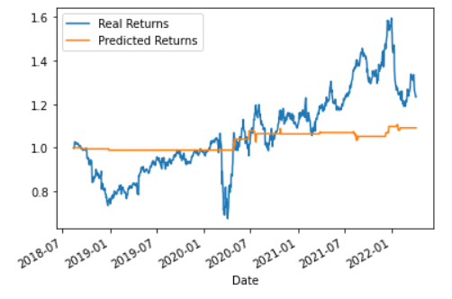
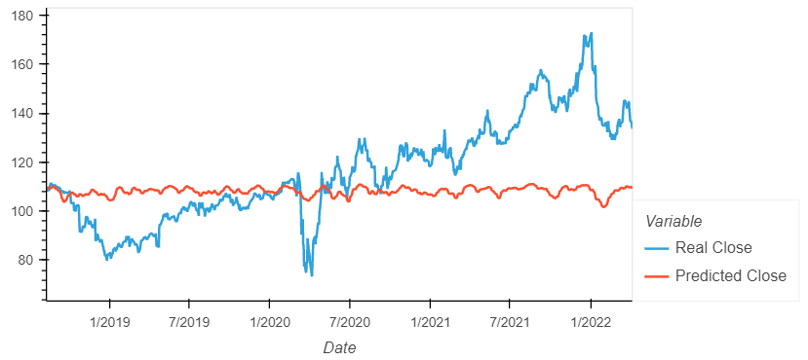
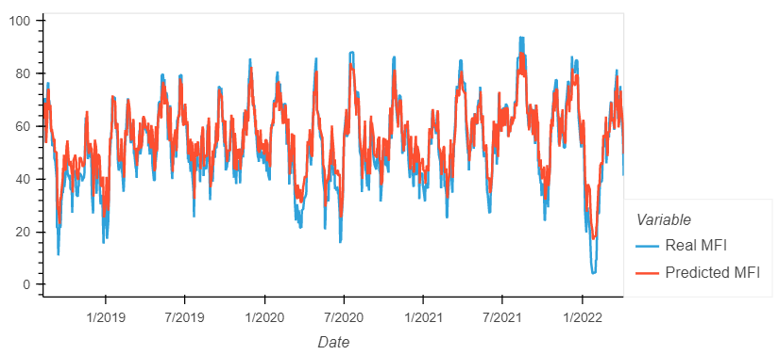
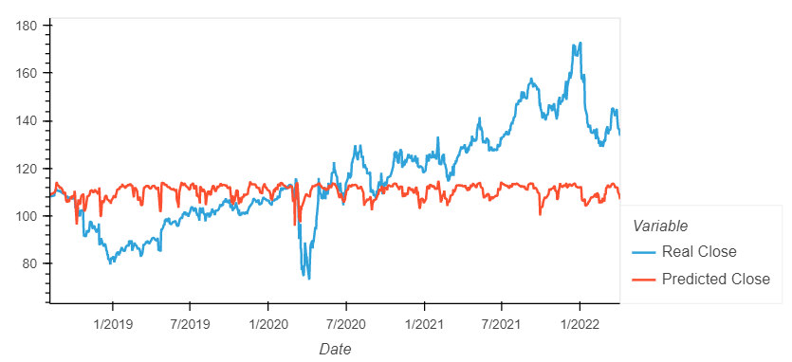
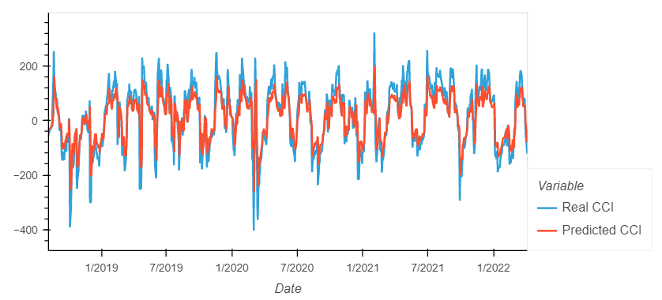
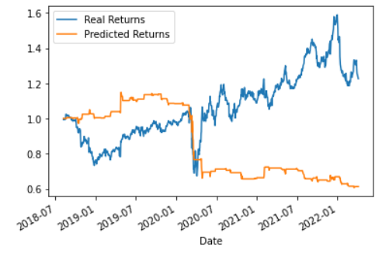
DGX
MFI
CCI
Using INDICATOR to predict CLOSE
Using INDICATOR to predict INDICATOR
Compared RETURNS

Slide 9
Conclusions
Conclusions:
Using LSTM on the indicator to predict the CLOSE price was very poor across the board, generally failed to capture big increases or decreases in price and stayed in a narrow band
Using LSTM on the indicator to predict the INDICATOR was much better, however, still trailed actual values and yielded much worse returns
There were no trends as to whether a model did better with a more or less volatile stock (low sample size
Models used were better at predicting simplistic, binary “Buy/Sell” (i.e. MACD) based on indicators versus multi-variable or trend change (e.g. from Buy to Sell, Buy to Hold, Hold to Sell, etc)

Slide 10
Thank you

